Slide 1
Mathematical methods in neuroscience
Sept 21, 2021

Slide 2
Why might neuroscientists need math or programming?
Handle large datasets (electrophysiological recordings, calcium recordings, behavioral video recordings)
Detect signals (e.g. action potentials) that are mixed with noise, or with other competing signals.
Construct models/simulations of brain function (not covered in this class).

Slide 3
Course outline:
Lectures 1-5, Tom Jhou: Signal processing
Lecture 1: Introduction to Python programming
Lecture 2: Filtering
Lecture 3: How filters work: convolution
Lecture 4: Spectral analysis
Lecture 5: Signal classification with PCA and ICA
Lectures 6-11, Takashi Sato: Deep learning

Slide 4


Python introduction
Created in 1991 by Dutch researcher Guido van Rossum at Centrum Wiskunde & Informatica, a mathematical research organization in Amsterdam.
Main strengths:
Free and open-source
Very active community developing tons of “libraries”, or extensions to the language.

Slide 5
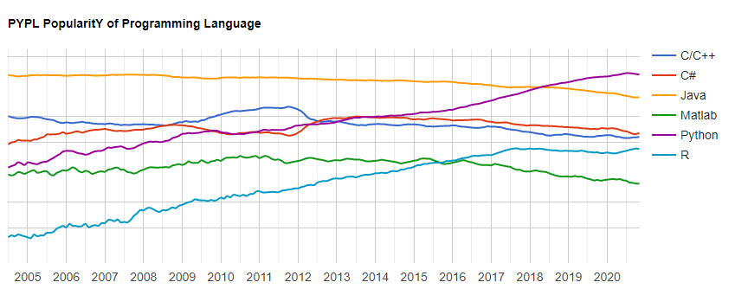
Python is gaining popularity (purple line)
http://pypl.github.io/PYPL.html

Slide 6
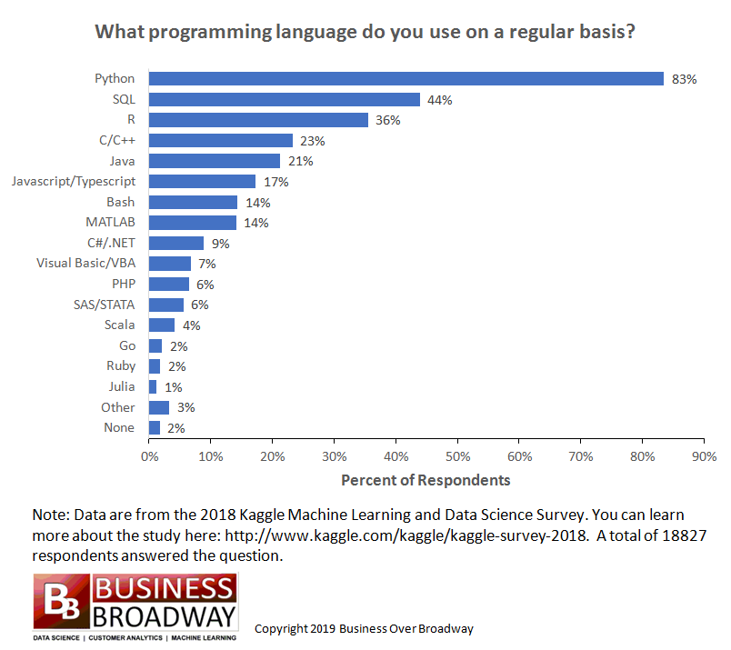
Python is #1 programming language by some measures:

Slide 7
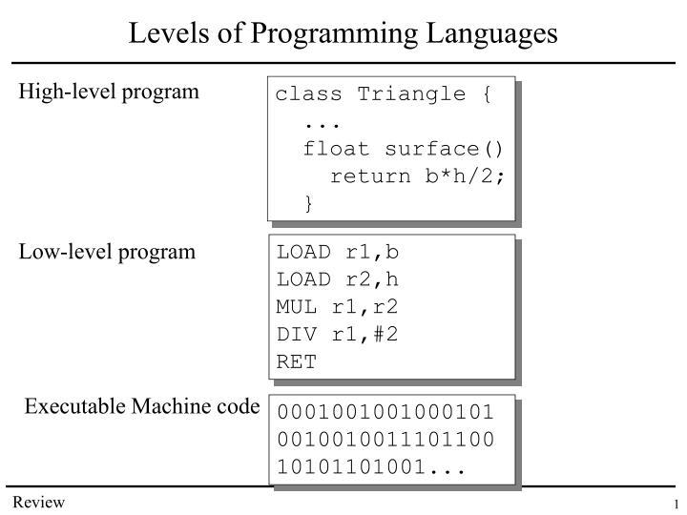
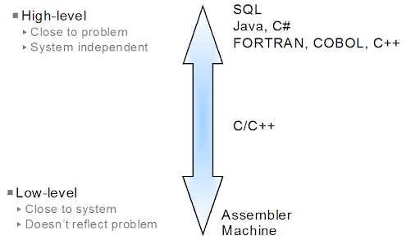
Python is a “high-level” language (along with most languages you will encounter)

Slide 8
Comparison with MATLAB
MATLAB
Python
Free everywhere, lots of free “library” extensions.
General purpose, rapid prototyping
Lots of on-line help, but it is chaotic. There seems to be 50 ways to do everything
Free at MUSC. >$2000 to buy on your own.
Optimized for matrix manipulations
Well-established community, lots of on-line help

Slide 9
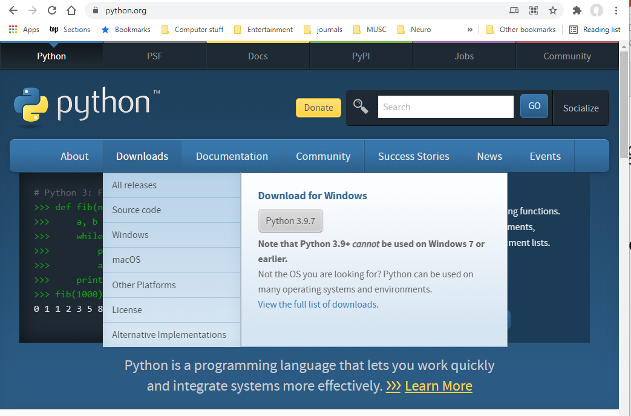
Download Python from www.python.org
Latest version is 3.9.7 (either Windows or Mac).

Slide 10

Install “PyCharm”, an “integrated development environment” (IDE)
Good IDEs make editing and debugging vastly easier.

Slide 11

Create blank PyCharm project by clicking button

Slide 12
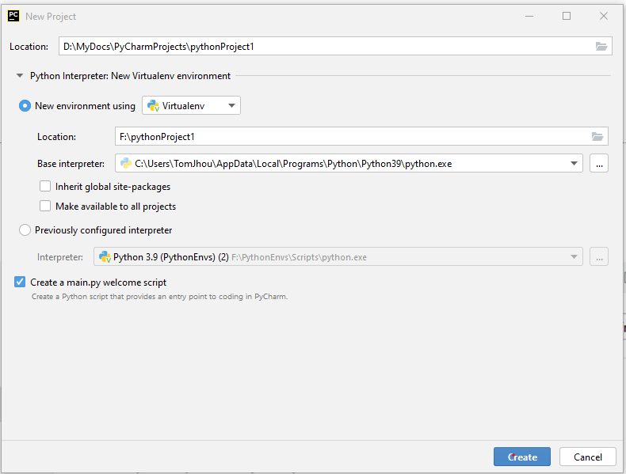
Select project location, “virtualenv” location, and interpreter:

Slide 13
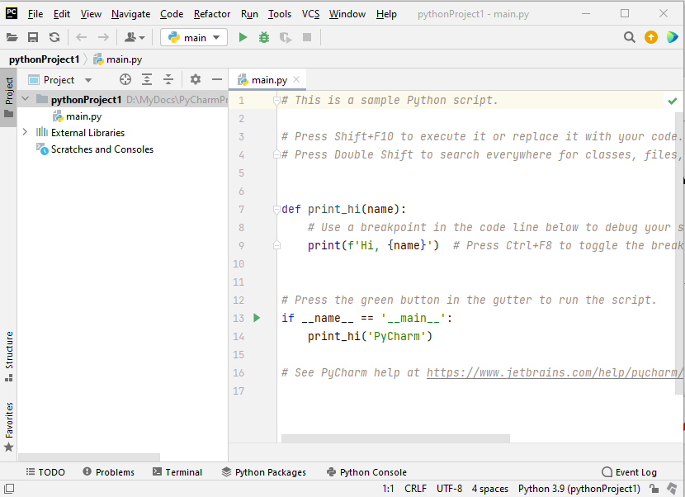
Script or console
Write instructions into a text file,
Execute them by pressing green triangle
You will write most of your programs here.
Can also select “Console”. Instructions
here are carried out as soon as you hit enter.
Useful for quickly trying stuff out.

Slide 14
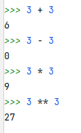
Console can be used as calculator. Just type expressions and hit <Enter>:
Green carets indicate Console prompt
What you type
Response from console
Raise number to a power

Slide 15
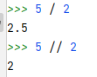
Two kinds of division (/ and //)
Normal division
Truncates fractional part (rounds down)

Slide 16
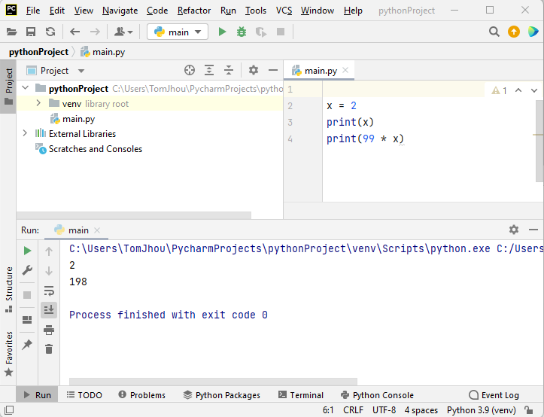
Can also type code into script window, then click run button (green triangle):

Slide 17
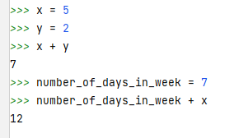
Store/retrieve values in variables:
Store value in x
Store value in y
Retrieve, sum values x, y
Can use long names to remind yourself what you are storing

Slide 18
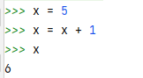
Can modify “in place”:

Slide 19
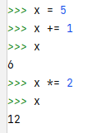
Shorthand notation:
Shorthand for x = x + 1
Shorthand for x = x * 2

Slide 20
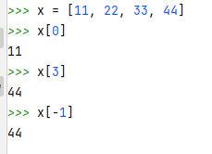
Variables can store lists of numbers (use square bracket notation):
Create and store list with 4 numbers

Slide 21
Retrieve elements of vector using zero-based index:
Retrieve first element (number 0)
Fourth element is numbered 3

Slide 22
Use negative index to count backwards from end:
Negative index counts from end

Slide 23
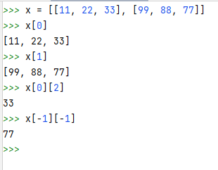
A list can contain other lists:
Use brackets inside brackets
First (zeroth) row
Second row

Slide 24
A list can contain other lists:
Third element in first row

Slide 25
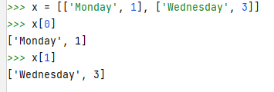
Lists can mix text and numbers:

Slide 26
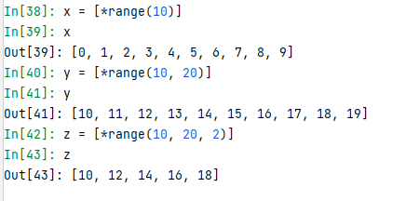
Use range() function to create consecutive numbers:
“unpacking” operator
Starts at 0, not 1
Does NOT include final number

Slide 27
Change start value (default = 0):
Specify start value other than 0
Does NOT include endpoint

Slide 28
Change increment (default = 1):
Step by 2 instead of 1
Does NOT include endpoint

Slide 29
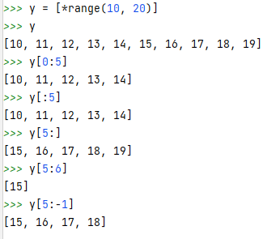
Extract multiple list elements using colon:
Extract elements 0 to 4
Omit start (assumes 0)
Omit end (assumes last item)
Same as y[5]
Negative numbers count from end

Slide 30

Concatenate two lists:

Slide 31
Python’s math abilities are limited. But you can add functionality with library called NumPy
Created in 2005. Originally called “Numerical Python extensions”, now just “NumPy”
Supports matrices/arrays, and many math functions (sin, cos, log, exponentials, etc)

Slide 32
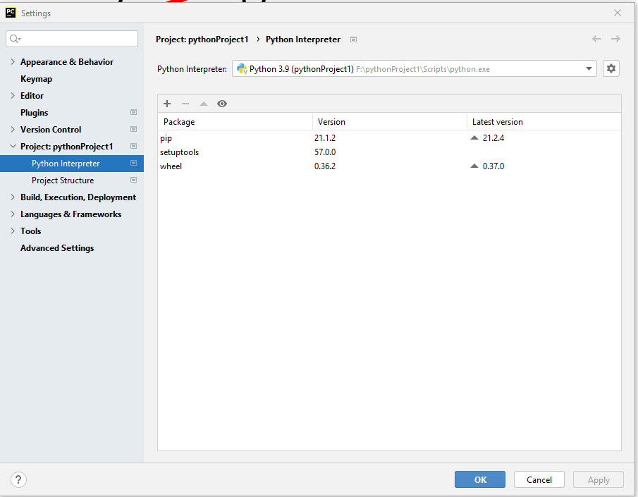
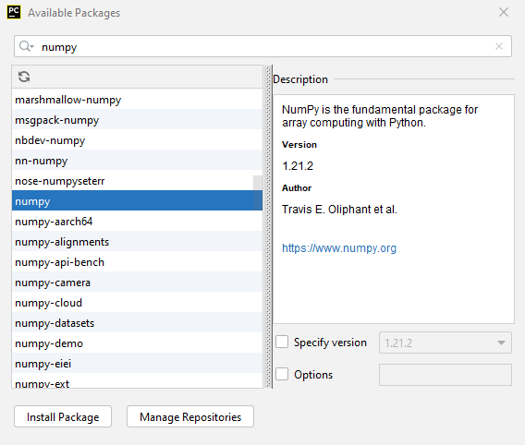
Click “settings”, “Python Interpreter”, then “+”
Type “numpy”, then click “Install package”:

Slide 33
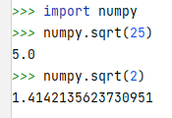
Now you have advanced functions like sqrt(), sin(), cos(), log(), etc.
Need to “import” at the start of every new session
Need “numpy.” before every function
Need “numpy.” before every function

Slide 34
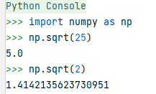
It’s a pain to type “numpy.” before every function. Can use abbreviation:
“as” keyword specifies abbreviation
Now we type “np” instead of “numpy”

Slide 35
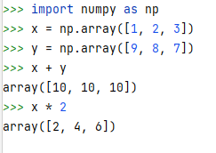
Numpy has “arrays”, which are like lists, but with vastly better numerical calculation capabilities

Slide 36
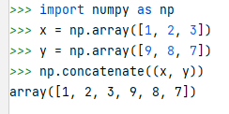

“+” no longer concatenates. There are dedicated numpy functions for that:
Join horizontally
“Stack” vertically

Slide 37
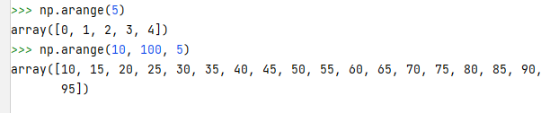
numpy.arange() function is an improved version of Python’s range() function

Slide 38
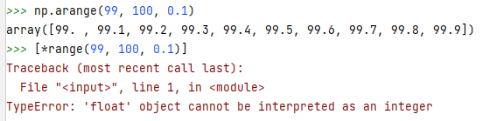
np.arange() allows decimals, whereas *range() only allows integers
“Float” refers to a “floating point” decimal number. Basically, any number that is not an integer.

Slide 39
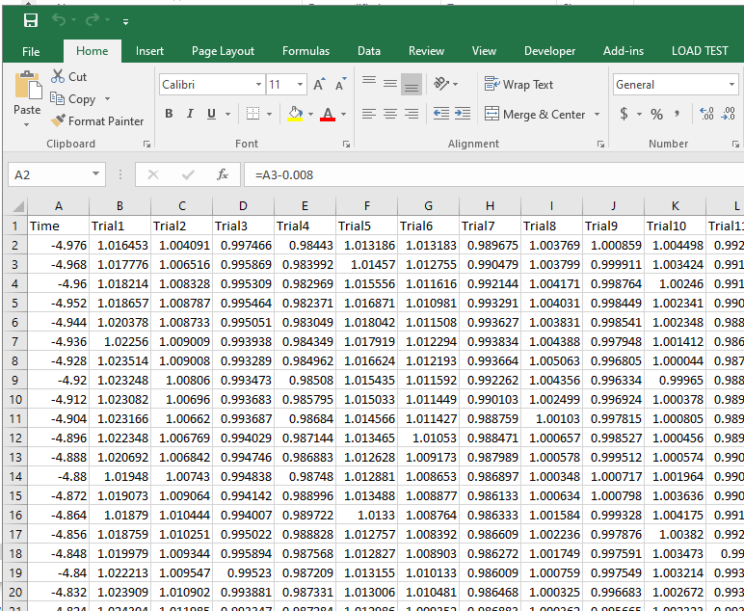
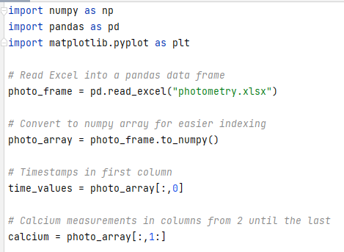
Read from Excel file into numpy array (via pandas array):
40 trials
Pandas = “Panel Data”, a Python data analysis library originally built to handle econometric data.
1831 time points, spaced 8ms apart

Slide 40
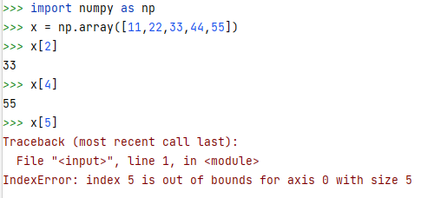
Access numpy array elements with same bracket notation as before

Slide 41
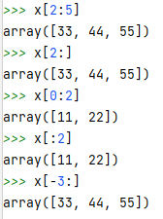
Extract consecutive elements using colon:
0 1 2 3 4

Slide 42
Negative indexes work too:
0 1 2 3 4
-5 -4 -3 -2 -1

Slide 43
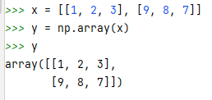
Create 2D numpy arrays from nested lists:

Slide 44
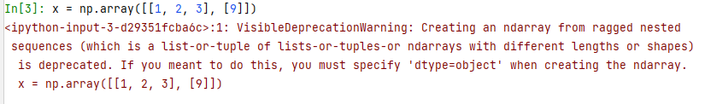
2D arrays must have same # elements in each row.
Otherwise you get a very long error message:

Slide 45
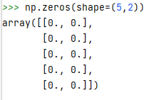
Create 2D numpy array of zeros:

Slide 46
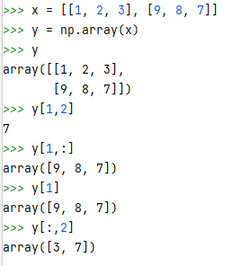
Bracket notation for 2D arrays uses pair of indexes, separated by a comma:
0 1 2
0
1

Slide 47
Extract entire rows:
Extract all columns from row 1 (second row)
Shorthand

Slide 48
Extract entire columns:
Extract all rows from column 2 (third column)

Slide 49
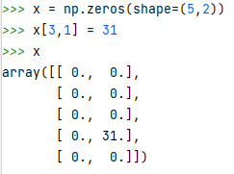
Can also modify single array elements:

Slide 50
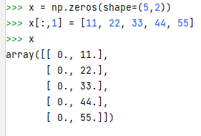
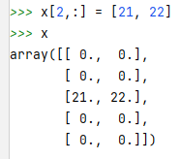
Modify entire row or column
colon means all columns
colon means all rows
Modify entire row
Modify entire column

Slide 51
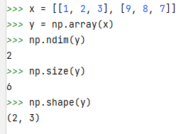
Determine array size using “shape()” function
Note round brackets, not square. This is a Python “tuple”, which is like a list but with “immutable” elements, i.e. cannot be altered without replacing entire object

Slide 52
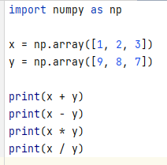
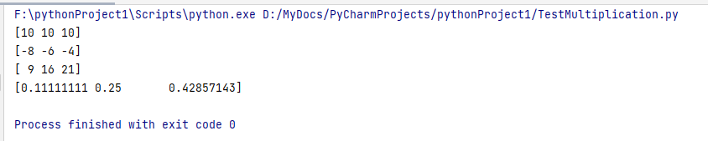
Arithmetic on numpy arrays

Slide 53
Homework:
Download this github repository: https://github.com/tomjhou/MathClassPythonCode

Slide 54
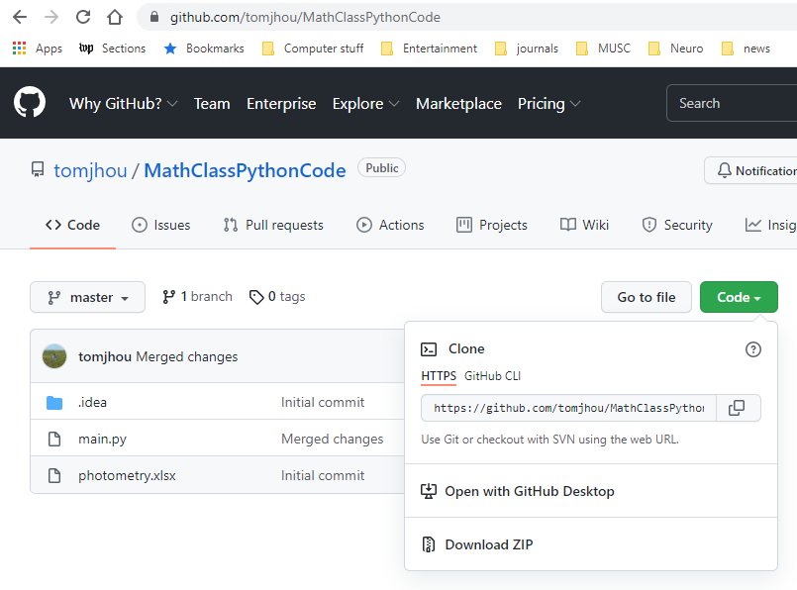
Download from browser
Click “Code”, then “Download ZIP”.

Slide 55
Run “main.py” (right click menu):
40 trials
1831 time points, spaced 8ms apart

Slide 56
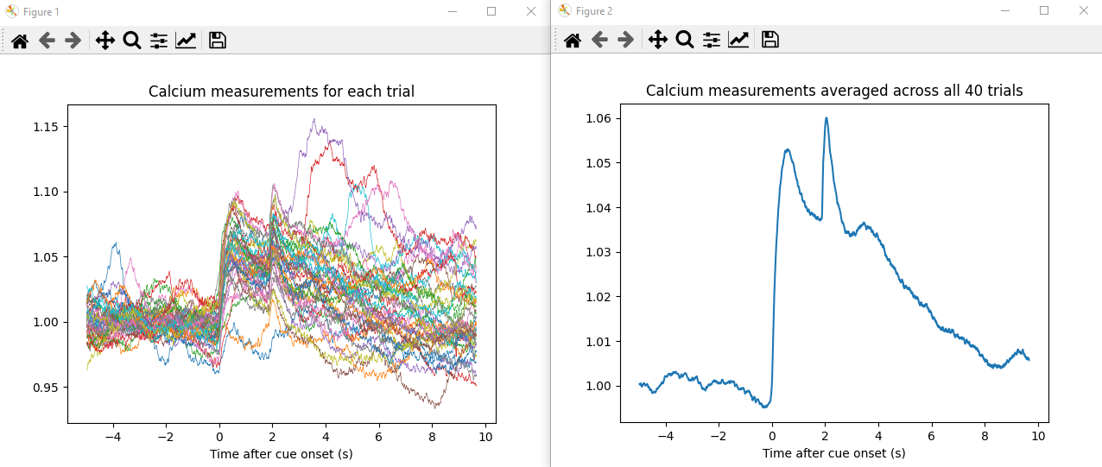
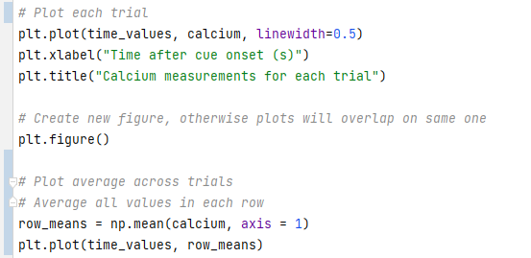
Should get two plots:

Slide 57
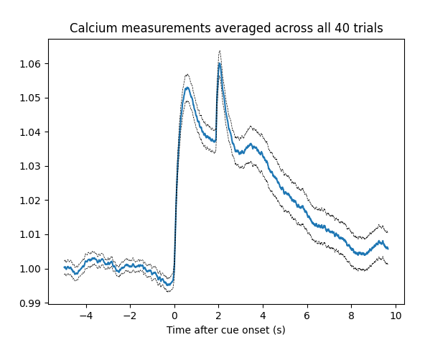
Homework: add standard error bands

Slide 58
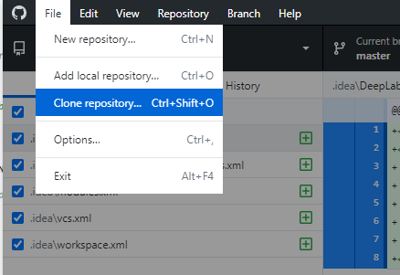
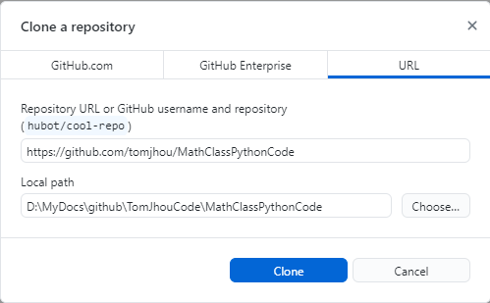
Can “clone” repository:
Download/install “Github Desktop” https://desktop.github.com/
Launch app.
Click “File/Clone repository”, then “URL”. Paste URL, click “Clone”:

Slide 59
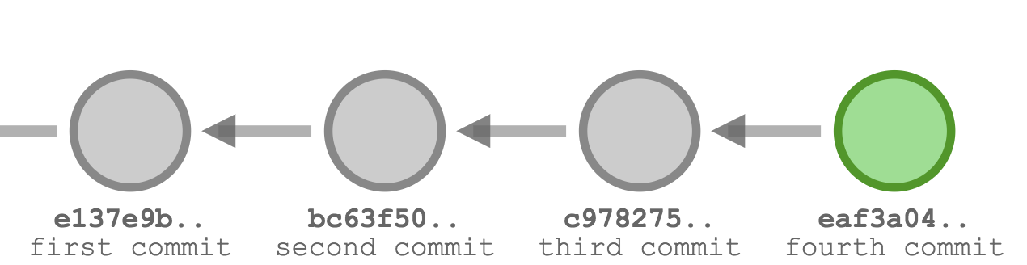
What are “git” and “github”?
“Git”: a type of “Version control system”.
Useful for tracking changes. Can “roll back” to any earlier version without losing later versions.

Slide 60
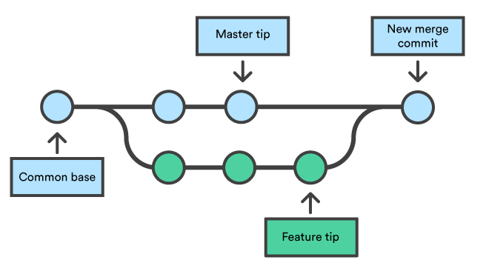
“git” allows edits on multiple branches:
Useful for testing prototypes without messing up original code.
When done, merge back with original

Slide 61
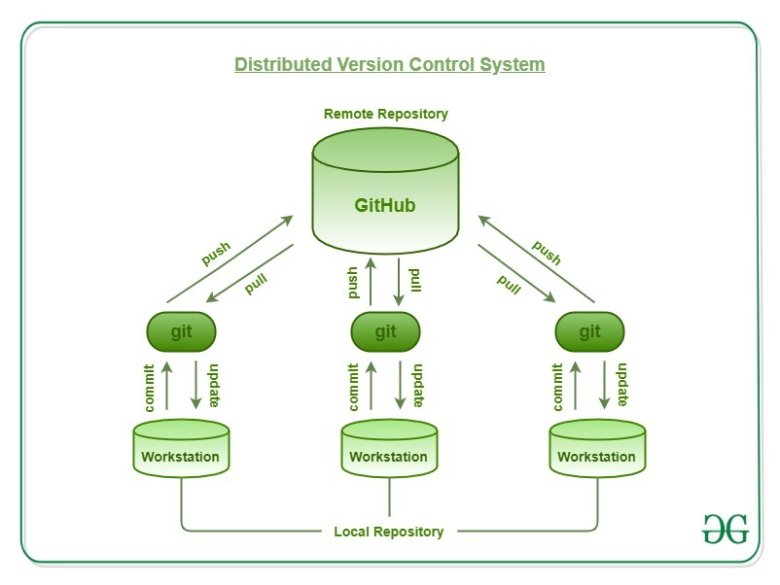
“github” is a popular cloud-based version of “git”
Each user has local copy of project.
Local changes can be “pushed” to the “remote” (cloud) server.
Users can “pull” changes from server.

Slide 62
Fun fact
“Git” was created by Linus Torvalds in 2005.
Same guy who made Linux in early 1990’s.

Slide 63
The End

Slide 64
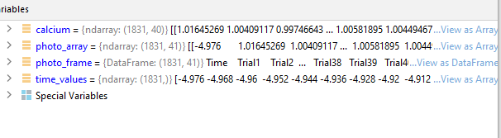
Note that variables include extra column for timestamps:
41 columns
(timestamp +
40 trials)
1831 rows, one for each time point

Slide 65
Vectors and Matrices
Matrices are simply grids of numbers.
A lot of complex tools are built on top of them. So we need to understand them well.

Slide 66

M x N matrix has M rows and N columns
Note: vertical dimension is always specified first.
This is opposite of the Cartesian convention.

Slide 67

Two ways to think about matrices:
1. Organizational – grouping numbers by row/column
E.g. rows = subjects, columns = replicates
2. Geometrical
Each row/column is a “vector” in n-dimensional space.

Slide 68

Geometrical
Each row defines a set of (x, y, z …) coordinates
… having a magnitude and a direction in N-dimensional space, where N is the number of columns

Slide 69

Terminology: row and column matrices
1 x N matrix = “row” vector
M x 1 matrix = “column” vector
“T” stands for “transpose”, switching rows and columns

Slide 70
Terminology: 1 x 1 matrix = “scalar”
A fancy term for a plain old normal number

Slide 71


Basic arithmetic on matrixes: adding/subtracting

Slide 72
You can multiply/divide matrices too, but this is complicated.
We’ll come back to this next week.

Slide 73

When debugging, variable browser is very useful:

Slide 74

Use “f” notation for user-friendly output text:

Slide 75


Easy way to create repeating elements:
Dog 1 2
Dog 1 2
Dog 1 2
Dog 1 2
Dog 1 2

Slide 76

Extend an existing list by one element:
Modifies existing list variable (overwrites previous contents).
Equivalent to x = x + [99]

Slide 77

Common operation on vectors: “dot product”
Two vectors must have same length.
Their “dot product” is the pair-wise sum of products of elements.
$\left[\begin{matrix}1 & 2 & 3\end{matrix}\right] ∙ \left[\begin{matrix}9 \\ 6 \\ 3\end{matrix}\right]$
= 1 * 9 + 2 * 6 + 3 * 3 = 9 + 12 + 9 = 30
You’ll have to trust me that this will be important.

Slide 78


Summation notation:
$\left[\begin{matrix}a_{1} & a_{2} & a_{3} … a_{n}\end{matrix}\right] ∙ \left[\begin{matrix}b_{1} \\ b_{2} \\ \begin{aligned}b_{3} \\ … \\ b_{n}\end{aligned}\end{matrix}\right]$
If A and B are n-dimensional vectors:
A = [a₁, a₂, a₃, … a_{n}]
B = [b₁, b₂, b₃, … a_{n}]
then the dot product of A and B is given by:
$$A∙B=\sum_{i=1}^{n}{a_{i}b_{i}}$$
$$a_{1}b_{1}+a_{2}b_{2}+a_{3}b_{3}+ …+a_{3}b_{3}$$

Slide 79
Three ways to think of dot product
Arithmetic
Pairwise sum of products
Geometric: Vectors in n-dimensional space
Geometric: Analogous to cross-correlation

Slide 80

Dot product of vector with self = Pythagorean theorem
Let A = [x, y] be a two-dimensional vector
Then A • A = x² + y² = hypotenuse²

Slide 81
This works in any number of dimensions
Let A = [a₁, a₂, a₃, … a_{n}]
Magnitude |A| = A • A = a₁² + a₂² + a₃² + … + a_{n}²
Vector “magnitude” denoted with vertical bracket notation

Slide 82
More general formula
If:
A = [a₁, a₂, a₃, … a_{n}]
B = [b₁, b₂, b₃, … a_{n}]
then
A • B = |A|*|B|*cos θ
… where θ is the angle between the two vectors.

Slide 83
Geometrical interpretation of dot product
Remember that a vector with n elements can be represented by an arrow in n-dimensional space. This arrow has a direction and a length
Notes:
All these vectors have the same magnitude = 5.

Slide 84

A very basic formula
Suppose a and b are two vectors.
Their dot product is product of magnitudes times cosine of angle separating their directions
Notes:
All these vectors have the same magnitude = 5.

Slide 85

Remember the cosine function
0 deg = parallel
90 deg = right angle
180 deg = opposite directions
Notes:
All these vectors have the same magnitude = 5.

Slide 86
Vector dotted with itself
Zero degree angle between vector and itself
cos(0) = 0
So dot product is magnitude squared, as we saw earlier
(x, y) • (x, y) = x² + y² = magnitude squared (hypotenuse)

Slide 87

Example #1:
a = (5, 0)
b = (4, 3)
a • a = 25 = |a|²
b • b = 4² + 3² = 16 + 9 = 25
Notes:
All these vectors have the same magnitude = 5.

Slide 88

Example #2:
(5,0) • (0,5) = 0
=90°
Notes:
All these vectors have the same magnitude = 5.

Slide 89

Example #2: orthogonal vectors
(3,4) • (-4,3) = -12 + 12 = 0
Notes:
All these vectors have the same magnitude = 5.

Slide 90
Example #3: opposite direction vectors
(3,4) • (-3,-4) = -9 - 16 = - 25
Notes:
All these vectors have the same magnitude = 5.

Slide 91
Example #4: neither parallel nor orthogonal
a = (5, 0)
b = (4, 3)
a • b = 5 * 4 = 20
Notes:
All these vectors have the same magnitude = 5.

Slide 92
Yep, the identity still holds
a = (a_{x} , a_{y}) = (5, 0)
b = (b_{x} , b_{y}) = (4, 3)
cos θ = adjacent / hypotenuse = 4/5
a • b = 20 = 25 * cos θ
|b|=5
=36.87°
b_{x} =4
Notes:
All these vectors have the same magnitude = 5.

Slide 93

Terminology: “unit” vector, length = 1.0
Can create by dividing any vector by its own magnitude.
b̂ = b / |b| = (4/5, 3/5) = (0.8, 0.6)
Verify:
0.8² + 0.6² = 0.64 + 0.36 = 1.00
(0.8, 0.6)
b̂
Notes:
All these vectors have the same magnitude = 5.

Slide 94


Dot product with any unit vector = length of shadow
Dot product of “a” with unit vector “u” is length of the “shadow” of “a” onto “u”
Notes:
Using the definition of cosine, we can “prove” the dot product for the special case where one vector lies along the x-axis.

Slide 95
A nice animation of what you just saw
https://www.youtube.com/watch?v=LyGKycYT2v0
Watch up to 4:21 …

Slide 96

What if number of dimensions is > 3?
Graphical intuition becomes much harder.
Can’t draw.
But basic ideas still hold.
There will be a plane containing both vectors. The angle between them (in that plane) still contains the angle of interest

Slide 97


It is common to work with vectors having hundreds of dimensions. How to visualize?
5D, etc
?
?

Slide 98
Two 4-D vectors, as 4 pairs of x,y coordinates
a₄*b₄ = +4
A | B
-2 | -2
-1 | -1
1 | 1
2 | 2
a₃*b₃ = +1
a₂*b₂ = +1
a₁*b₁ = +4
Dot product = + 10

Slide 99
Slightly rearrange the numbers
a₁*b₁ = -4
A | B
-2 | 2
-1 | 1
1 | -1
2 | -2
a₂*b₂ = -1
a₃*b₃ = -1
a₄*b₄ = -4
Dot product = - 10

Slide 100

This method works even with high-dimensional vectors
(a₁, a₂, a₃, …) • (b₁, b₂, b₃, …) = $\sum_{i=1}^{n}{a_{i}b_{i}}$
Two 25-D vectors, A, B
A | B
0.256574 | -0.47409
-1.06162 | 0.104613
0.205486 | 1.000592
1.381874 | 1.641875
-0.3789 | -1.03427
1.32869 | 0.189985
1.344438 | 1.911619
1.461591 | 0.914581
1.554256 | 0.737026
0.889833 | 0.963659
-1.24735 | -0.24158
-0.75902 | -1.52722
-1.43461 | -0.8119
-0.00607 | 0.716201
-0.26062 | -0.11456
-0.54498 | -1.19385
0.328155 | 1.284383
-1.16679 | -0.55996
-0.05578 | -0.48953
-1.24326 | -0.80473
1.313789 | 1.361102
0.58111 | -0.63932
-0.06765 | -0.30031
-1.54698 | -0.91348
-0.87219 | -1.72084

Slide 101


Note similarity to cross-correlation formula:
From Wikipedia, Pearson’s cross-correlation coefficient “r”:
Suppose each vector has mean = 0. Then this becomes:
$$r= \frac{\sum_{i=1}^{n}{(a_{i}−\overline{a})(b_{i}−\overline{b})}}{\sqrt{\sum_{i=1}^{n}{{(a_{i}−\overline{a})}^{2}}}\sqrt{\sum_{i=1}^{n}{\left(b_{i}−\overline{b}\right)2}}}$$
$$r= \frac{\sum_{i=1}^{n}{a_{i}b_{i}}}{\sqrt{\sum_{i=1}^{n}{a_{i}^{2}}}\sqrt{\sum_{i=1}^{n}{b_{i}^{2}}}}= \frac{A∙B}{\sqrt{A∙A}\sqrt{B∙B}}=\frac{A∙B}{\left|A\right||B|}$$

Slide 102

Dot product is proportional to Pearson’s r:
Pearson’s r is positive along y=x diagonal, negative along y=-x diagonal, and intermediate elsewhere
Dot product behaves similarly

Slide 103


Dot products in Python

Slide 104


Matrix multiplication in Python

Slide 105

Matrix multiplication is a set of dot products of each row of X, with column of Y

